Slide 1
Day 6 PPT
Git clone and sending files to git

Slide 2
Some git commands
git init : Create an empty Git repository into a nw directory.
git clone : Clone a repository into a new directory.
git add : Add file contents to the index.
git commit : Record changes to the repository.
git rebase : Reapply commits to the repository.
git status : Show the working tree status.
git pull : Fetch from and integrate with another repository or a local branch

Slide 3
Git commands
git fetch : Download objects and refs from another repository.
git switch : To switch branches
git merge : Join two or more development histories together
git diff : Show changes between commits, commit and working tree,etc.
git tag : Create , list ,delete or verify a tag object signed with GPG.
git show : Show various types of objects.
git log : Show commit logs

Slide 4
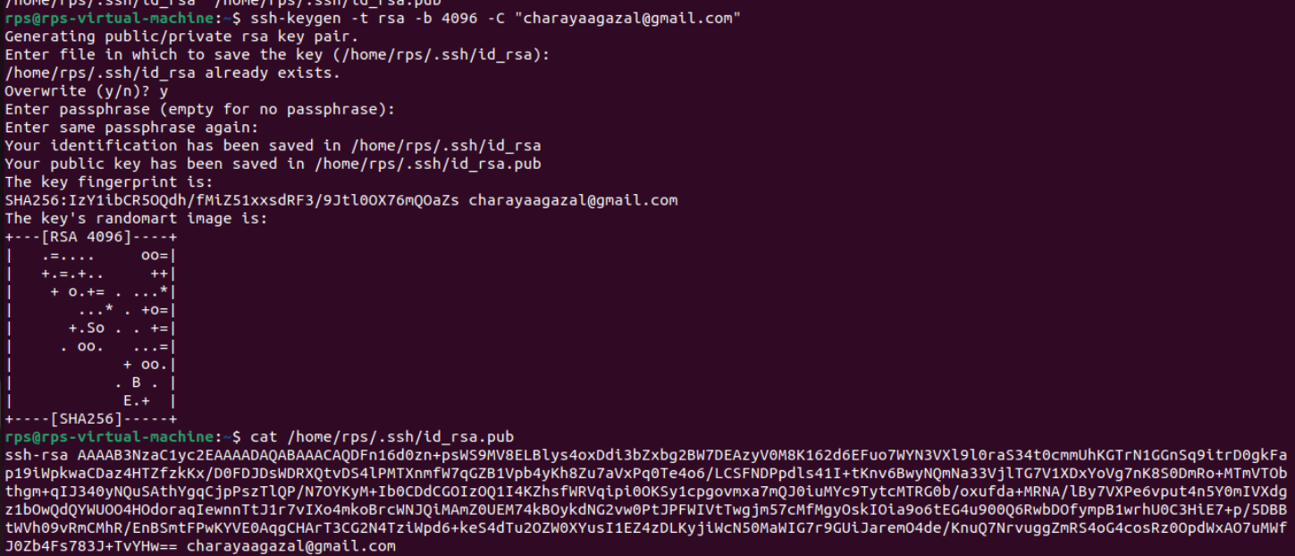
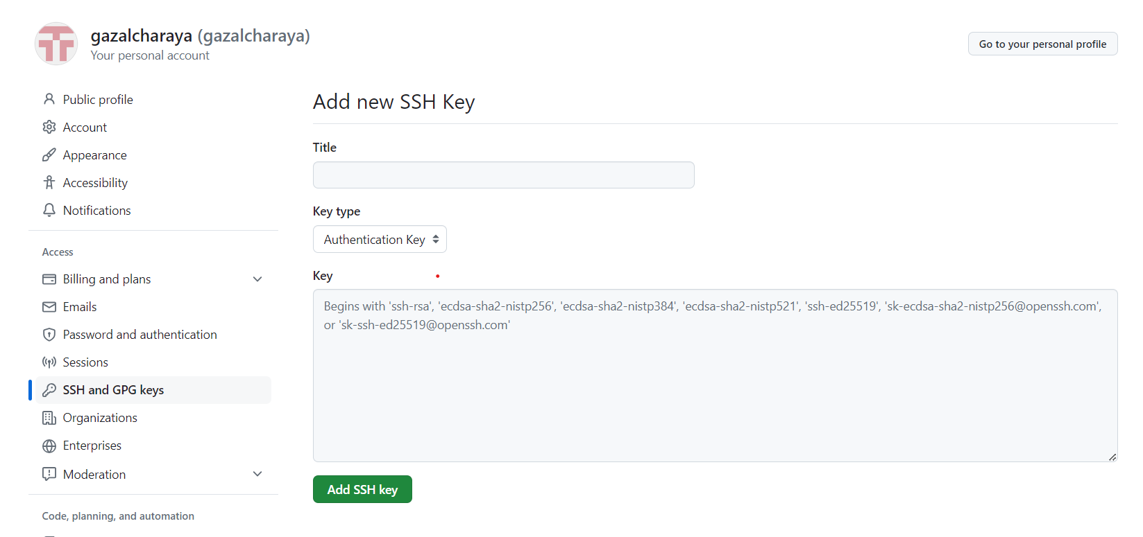
CREATING SSH KEY
Create ssh key using ssh-keygen
Use cat (path where u run ssh key) and copy the key
Paste here in key

Slide 5
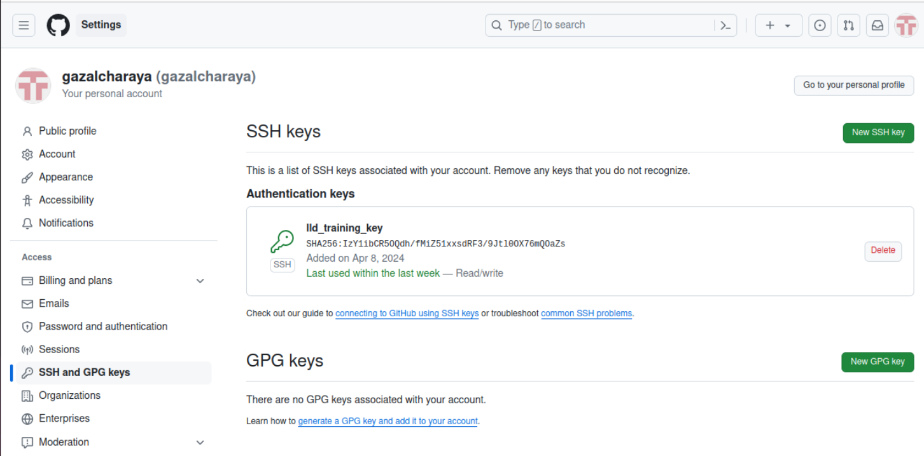
Our ssh key successfully created

Slide 6
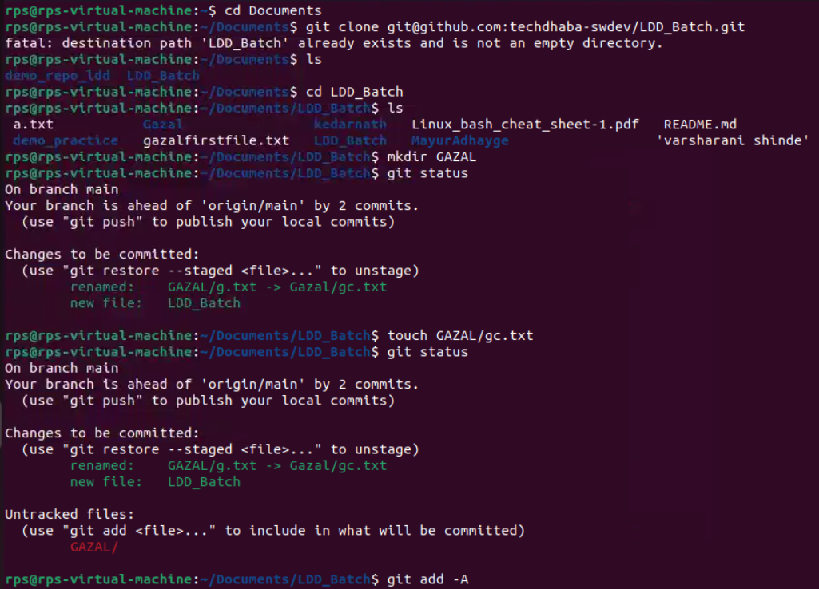
MOVING FOLDER INTO GIT
Make GAZAL directory and gc.txt in same directory
Using git add -A
To add files

Slide 7
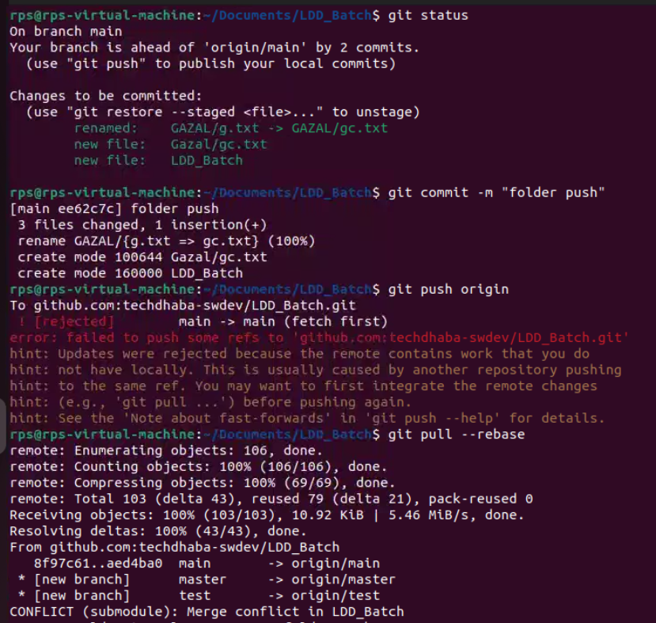
Commit message “folder push”
Then git push origin-its giving error
so we have to pull
Use git pull --rebase

Slide 8
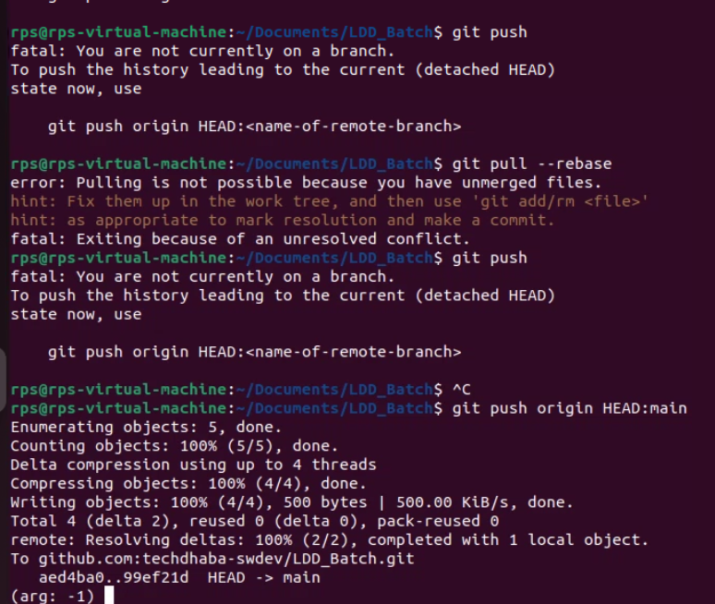
After pulling ,I again use push command
-it says you are not currently on branch
So use git push origin HEAD:main

